Slide 1
WOMEN’S POLITICAL PARTICIPATION AND LEADERSHIP ASSESSMENT: KYRGYZ REPUBLIC
Findings Presentation
Date: 2023

Slide 2
AGENDA
-Assessment Purpose & Approach
-Methodology
-Barriers & Opportunities
-Recommendations

Slide 3
ASSESSMENT PURPOSE AND APPROACH
The study of women’s political leadership in the Kyrgyz Republic investigated the barriers to and opportunities for expanding women’s participation and leadership in the political landscape.
It used the Women’s Political Participation and Leadership (WPPL) Assessment Framework to document women’s access to and power in politics along sociocultural, institutional, and individual dimensions.
The assessment analyzed WPPL through the lenses of access and power.
USAID can use the report’s findings to identify priority areas in which its investments are likely to have the greatest impact.
Notes:
Provide brief background on the framework – highlighting what audience needs to know to follow presentation. Can abbreviate further if audience is assumed to be familiar.

Slide 4
METHODOLOGY
Desk Review
Key Informant Interviews
Fifteen politicians (eight women, seven men)
Five civil society and media representatives (four women, one by text)
Four donors and implementing partners (two women, two men)
Two academics (one woman, one man)
One man electoral officer
Three USAID/Embassy staff (two women, one man)
Notes:
Details include geographic coverage, number of surveyed politicians, number and type of KIIs, number and type of FGDs.

Slide 5
METHODOLOGY—FOCUS GROUP DISCUSSION
NO. | GROUP DESCRIPTION | LOCATION | TOTAL PARTICIPANTS
1 | Local Council Members, Men | Saruu Village, Issyk-Kul Oblast | 5
2 | Local Council Members, Women | Saruu Village, Issyk-Kul Oblast | 4
3 | Local Activists, Men | Saruu Village, Issyk-Kul Oblast | 10
4 | Local Activists, Women | Saruu Village, Issyk-Kul Oblast | 12
5 | Local Council Members, Men | Novo-Pokrovka Village, Chui Oblast | 4
6 | Local Council Members, Women | Novo-Pokrovka Village, Chui Oblast | 7
7 | Local Activists, Men | Novo-Pokrovka Village, Chui Oblast | 9
8 | Local Activists, Women | Novo-Pokrovka Village, Chui Oblast | 10
9 | Participants of School for Youth provided by PP, Boys | Bishkek City | 5
10 | Participants of School for Youth provided by PP, Girls | Bishkek City | 6

Slide 6
METHODOLOGY—SURVEY
POLITICAL PARTY | GENDER | NO. OF SURVEYS
Ata Zhurt Kyrgyzstan | Women | 9
 | Men | 10
Yiman Nuru | Women | 8
 | Men | 7
Yntymak | Women | 10
 | Men | 12
Alliance | Women | 7
 | Men | 9
Social Democrats | Women | 12
 | Men | 9
POLITICAL PARTY | GENDER | NO. OF SURVEYS
Emgek | Women | 9
 | Men | 5
Ordo | Women | 1
 | Men | 0
Ishenim | Women | 1
 | Men | 0
Ata Meken | Women | 0
 | Men | 1
Total Women = 57, Total Men = 53

Slide 7
BARRIERS & OPPORTUNITIES

Slide 8
SOCIOCULTURAL
Barriers
Gender norms
Perceptions of women
Violence against women in politics and public life (VAWPPL)
Patriarchy
Opportunities
Gender quota
“Deputies who came to the [local] council…after the introduction of the quota mechanism are constantly questioned about their achievements and are almost threatened to justify the quota mechanism. Such questions come from journalists, from members of the local community, and even from individual politicians at the national level. At the same time, none of these "evaluators" ever conduct the same assessment of the activities of men MPs.” (Former local councilor and civil society activist, woman)

Slide 9
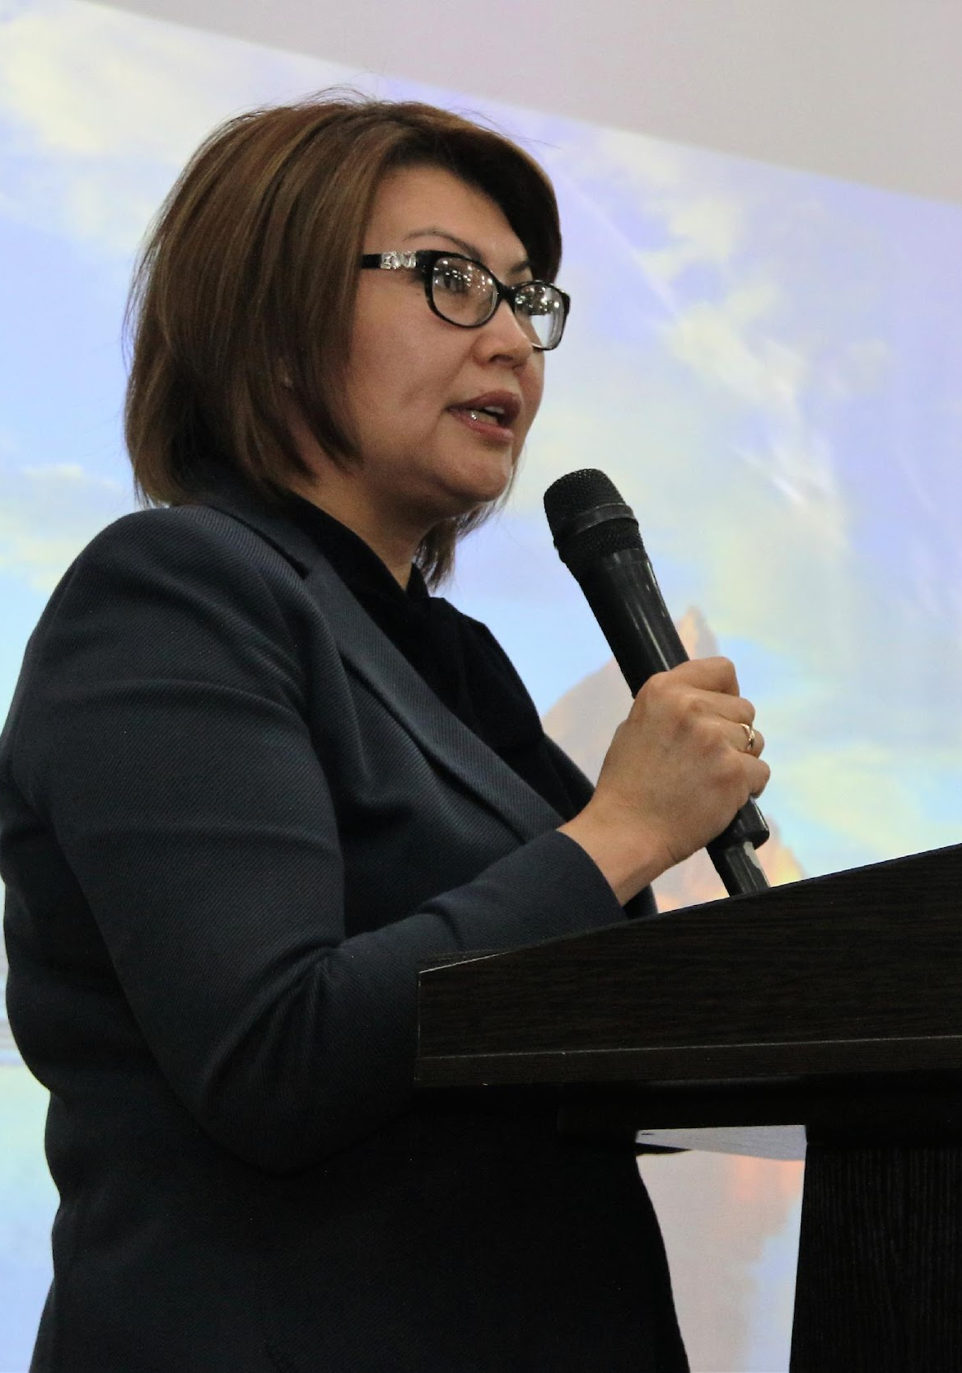
INSTITUTIONAL
Barriers
Governmental and non-governmental support
Political parties
Opportunities
Legal framework

Slide 10
INDIVIDUAL
Barriers
Knowledge, skills, and confidence
Women’s competing roles
Family support
Women’s networks
Financial assets
“It is more difficult for women to enter and be in politics. Overall, expectations of others from her are higher, and her expectations of herself are high, too—she considers whether she has enough skills and whether she can perform well, etc. While men do not have high expectations of themselves.” (Government official, woman)

Slide 11
SELECTED RECOMMENDATIONS

Slide 12
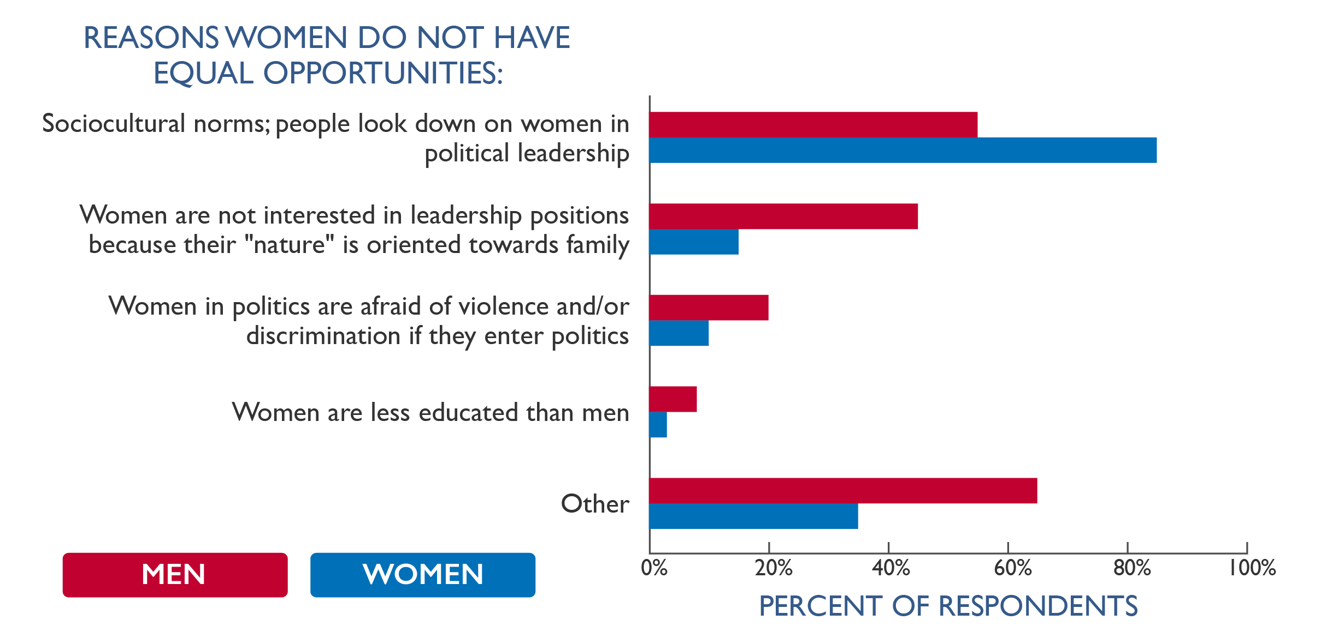
SOCIOCULTURAL
Journalist and media training for gender sensitivity
Support civil society and media
Engage men gatekeepers
Notes:
Main reasons women do not have equal opportunities in positions of political leadership (n=57), Politician Survey. (See p. 25 of the report.)

Slide 13
INSTITUTIONAL
National Gender Strategy (NGS) and gender empowerment goals
Combat VAWPPL
Political advocacy to clarify the quota system
Equal treatment of women candidates
Opportunities for women politicians to network and caucus

Slide 14
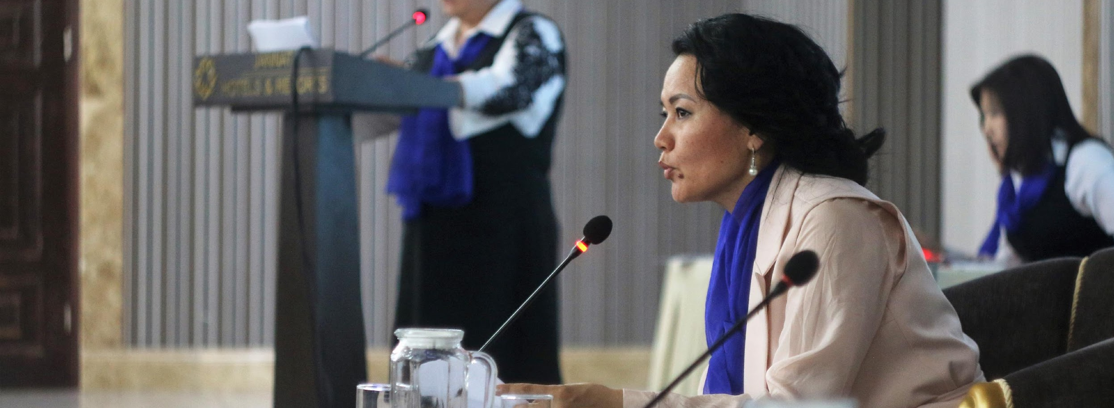
INDIVIDUAL
Civic education
Capacity and skills among women candidates and politicians
Train women politicians in media skills
Training and orientation for women councilors

Slide 15
QUESTIONS?

